Slide 1
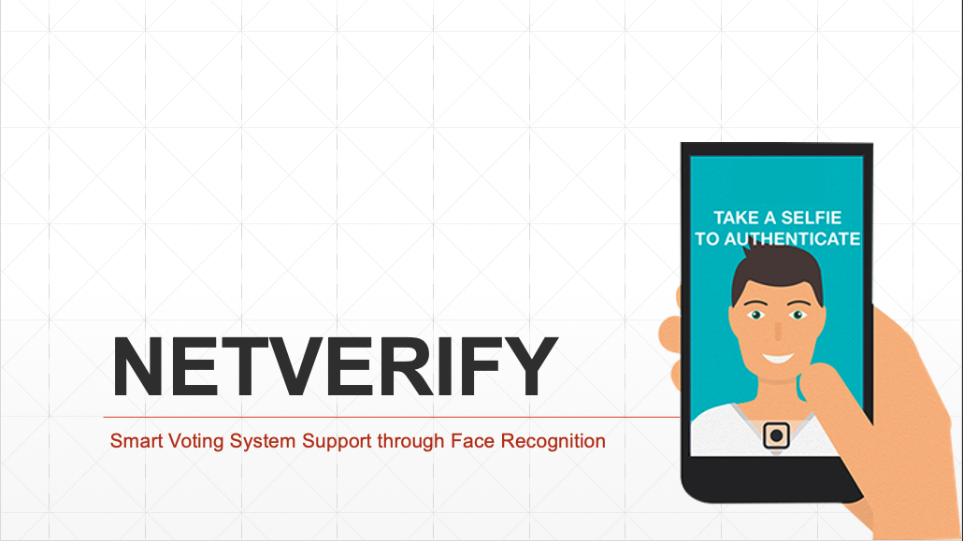
We build VALUE for your business By PowerPoint Presentations
BY : KANDULA VINAY KUMAR REDDY

Slide 2
01
Introduction
02
Existing System
Presentation
Agenda
03
Face Recognition for Voting
04
Merits of Proposed System
05
Conclusion

Slide 3
INTRODUCTION
INDIA, A County With Deep Roots & Rich Diversity, The Country With Largest Democracy In The World. The Ability To Choose Your Ruler Though An Election Is An Important Component Of The Democratic Society , so it must be transparent, Meddle-Proof, Usable, Authenticated, Accurate, Verifiability and Mobility. Existing system which is not safe & unsecure because
1.Dummy voting
2.Out of town
3.tampering
Same person casting vote multiple times instead of died persons, people out of station in favor of a candidate.
Most of the people do not participate in voting as their booth to vote is far from where they live (or) there is no transportation.
Some candidates to win the elections tamper the voting machines to get results in favor to them which is a serious malpractice.

Slide 4
INTRODUCTION(Cont.)

Slide 5
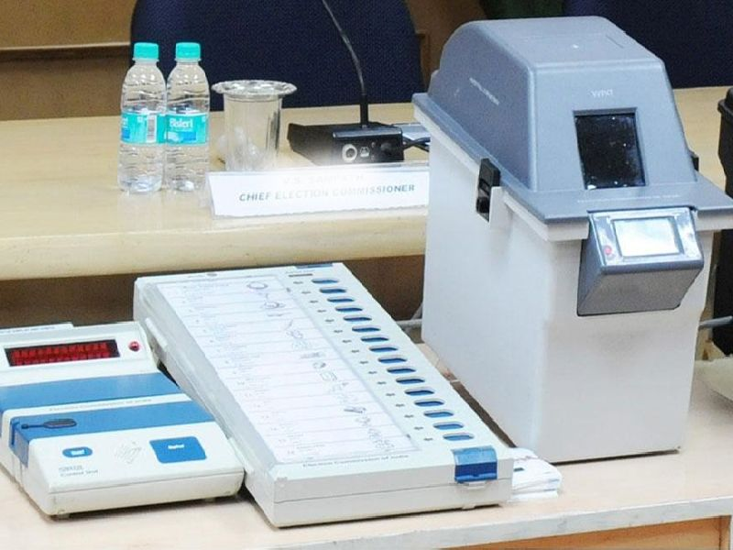
existing system
Existing system is of two different types
[1] Secret ballot paper, in which lots of paper are used and [2] EVM (Electronic Voting Machine) which is used since 2003.
The existing system of voting - EVM includes the following steps
VOTER’S ID AND IDENTITY VERIFICATION
voter need to reach at polling booth. The first step is the identity verification , carried out by an associated person on the duty.
OFFICER MARK LEFT FINGER
Then officer makes mark of inedible ink on the voter’s left forefinger thereafter voter has to sign in register followed by reaching inside the voting compartment
VOTER’S CAST VOTE USING EVM MACHINE
To mark a vote, a voter has to press blue candidate button on EVM machine against the name and symbol of his/her choice. When the button is pressed, the red lamp will glow against the symbol with beep sound which indicates that vote is successfully recorded.

Slide 6
existing system
The Existing System involves lot of man power and problems faced with existing system are
1.Lot of man power
It requires lot of man power at different polling stations for person identification
2. Distant station
In existing system person has to visit the station in his constituency to cast the vote .
3. percentage
Using existing system it is difficult to calculate the exact voting percentage.
4.Malpractices
As identification is done by human most of the cases results in dummy voting which is not safe because some has multiple votes in multiple locations.

Slide 7
Sarcastic note on existing system
Here is a meme on existing voting system with a lot more meaning to find (not support to any political party Just to say criticizers point of view)

Slide 8
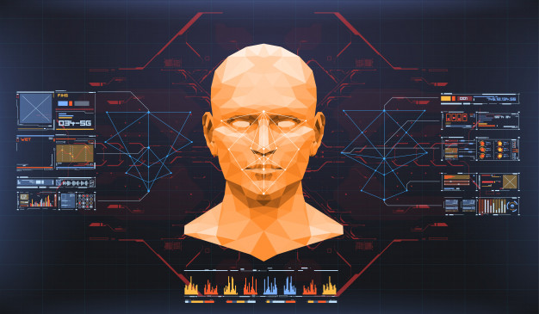

Slide 9
face
recognition
for
voting
Why smart voting?
Why face recognition?
The Smart voting system tends to maximize user participation, by allowing them to vote from nearest polling centre.
The reduction in organizational and implementation costs significantly increases the efficiency of election management compared to traditional paper voting, for example.
Facial recognition is a type of biometric technology that analyses the characteristics of a person’s face to identify or verify a person
Facial recognition technology provides verification that is convenient, quick, non- contact process and accurate . Which in turn beneficial to prevent fraud.

Slide 10
“Our lives begin to end the day we become silent about things that matter.”
By:
MARTIN LUTHER KING

Slide 11
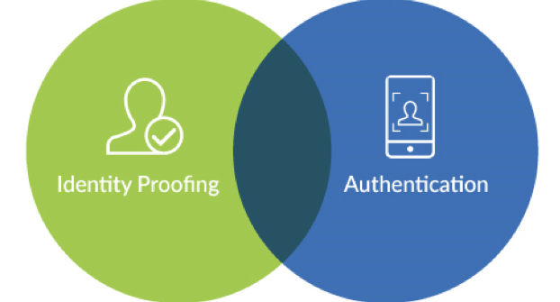
Lack of overlap
From decades there is lack of overlap of these two important parts

Slide 12
Smart voting system process
The below steps shows the simple process involved in smart voting system using face authentication
Get Registered
Allocation of eid(Electoral id)
Authentication
voting
While registering to vote give details of your UID(Unique Identification Number)
For each individual there allocated a database having set of images , UID number and a EID (Electoral ID) is assigned
During voting day the EID number of person to be entered into system and the device captures person Image authenticates if the EID of image in database and entered EID is matched if so authentication successful and person can cast his vote.
After the authentication is successful an individual gets the list of candidates of his constituency in a screen to cast his vote.
01
02
03
04

Slide 13
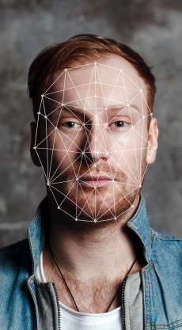

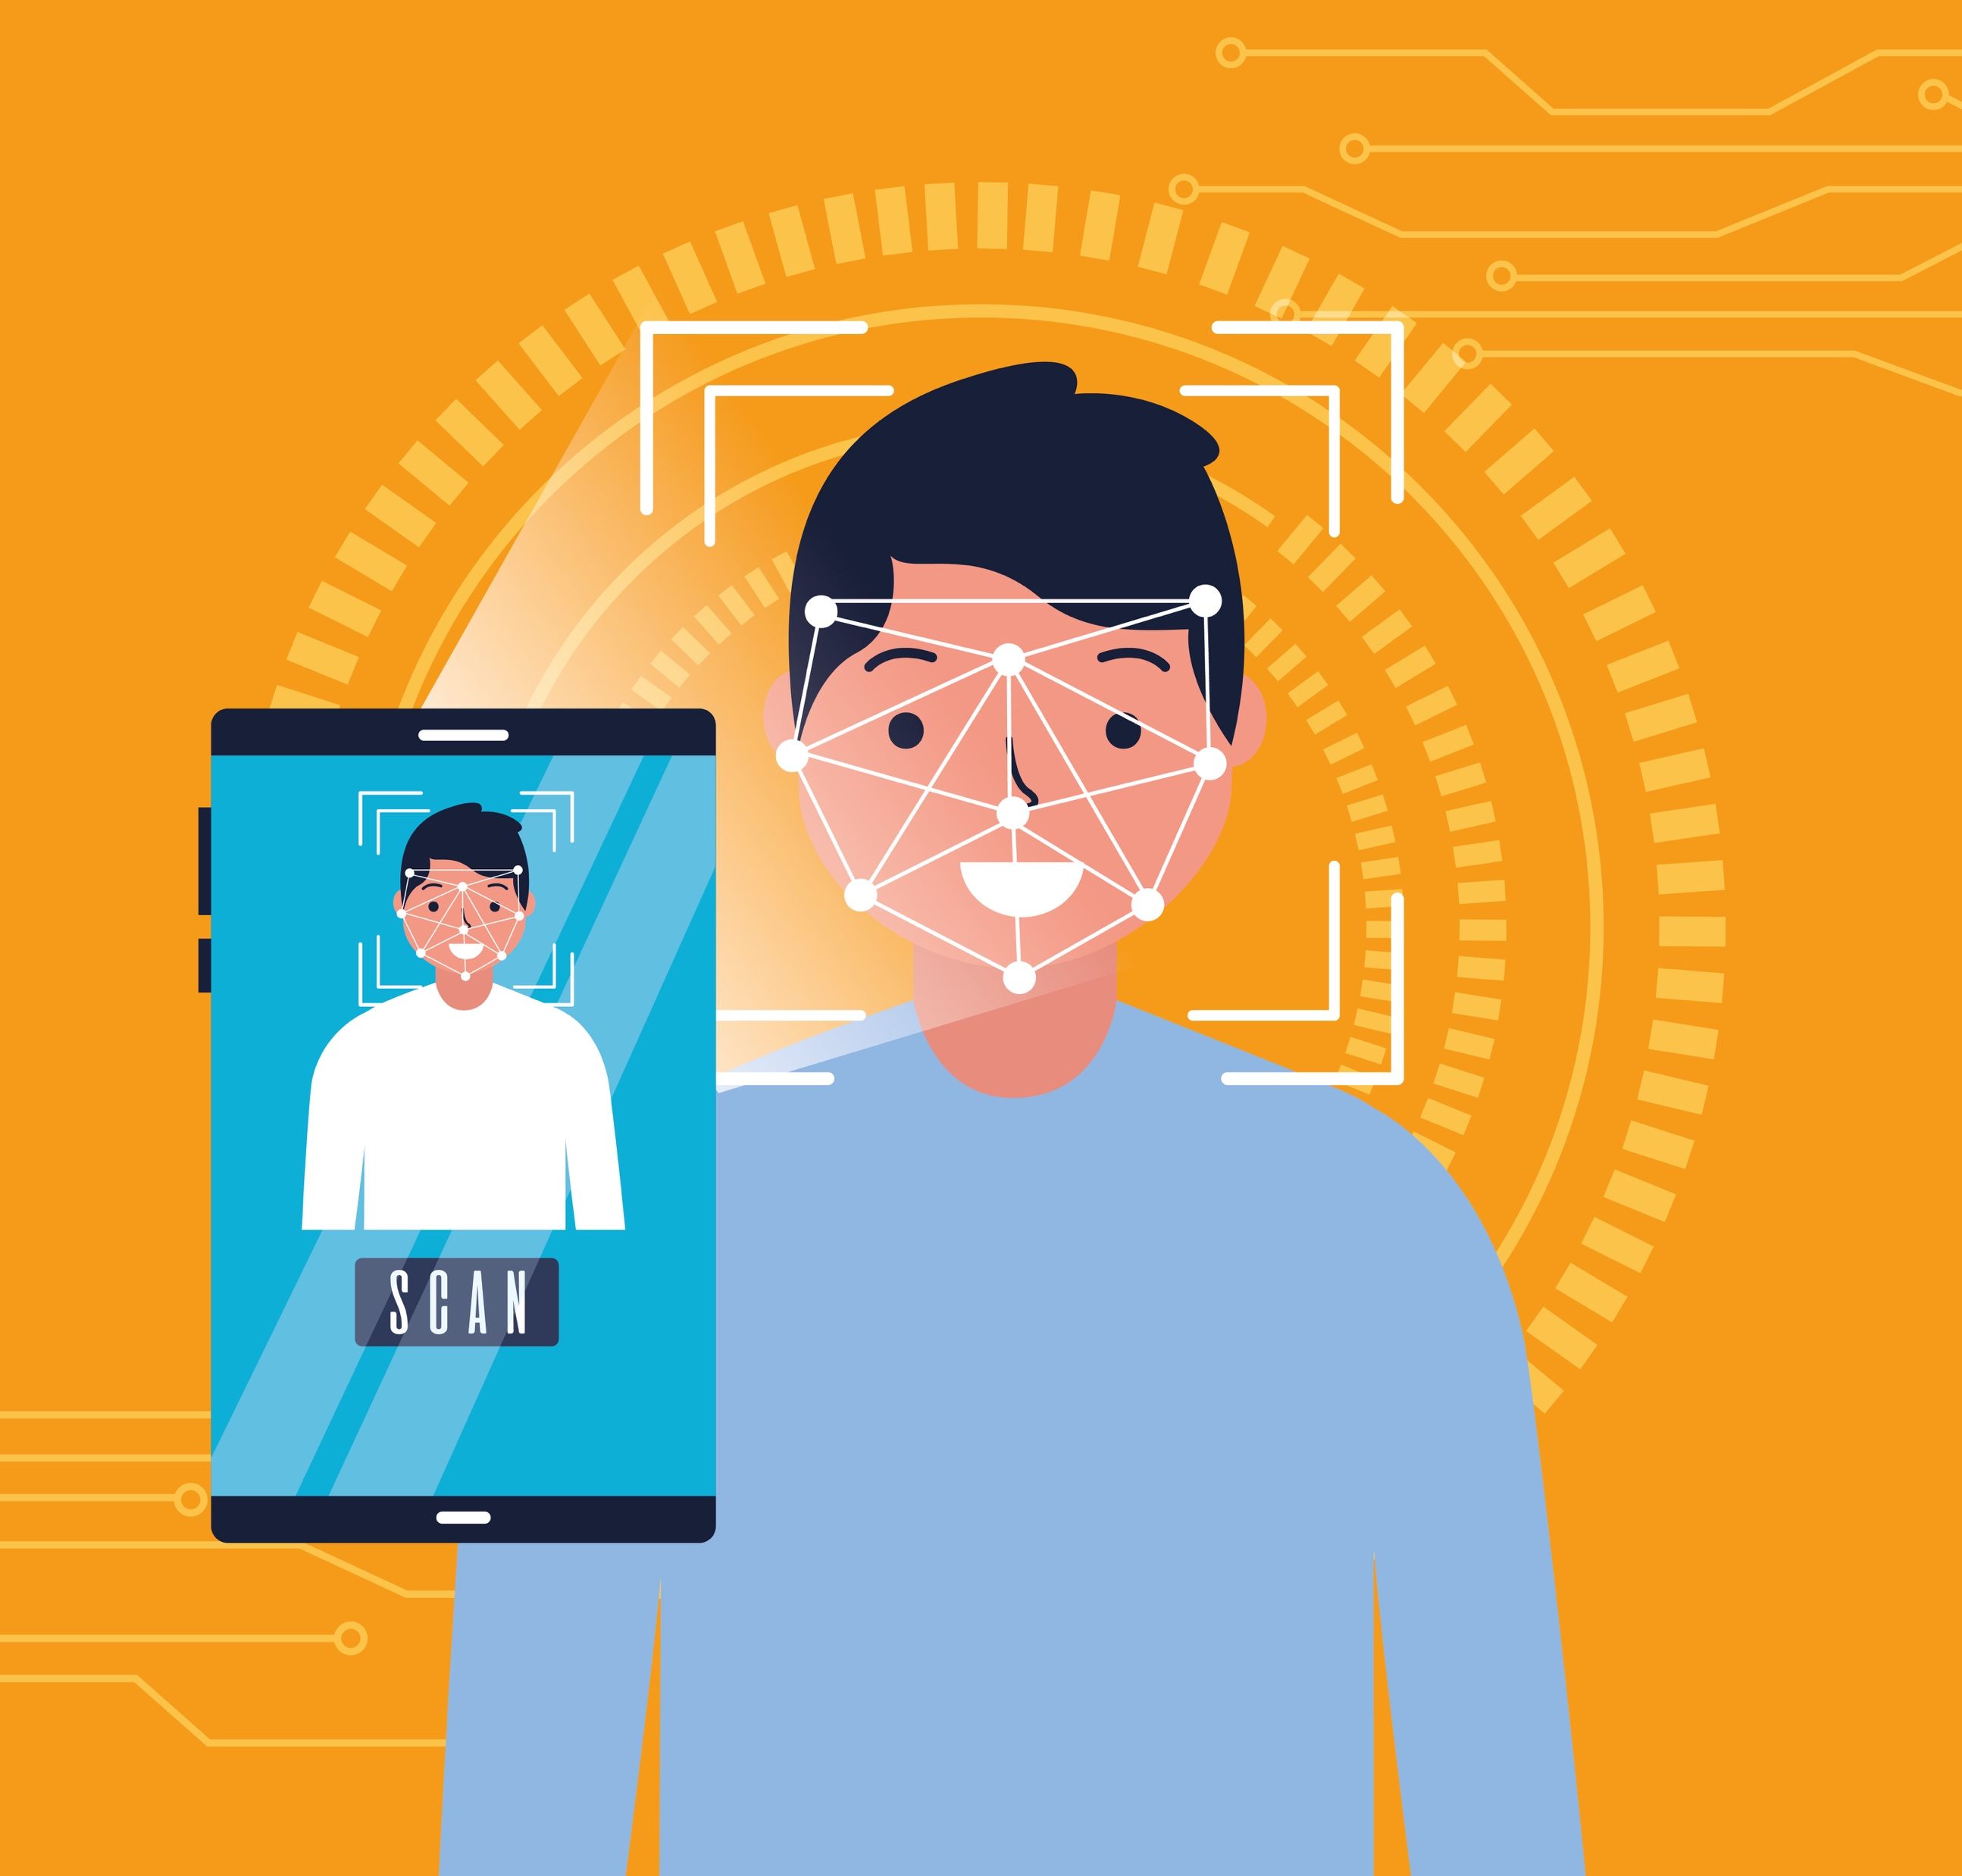
Project Mockup Showcase
This slide is to showcase mockups of how the entire system looks like

Slide 14
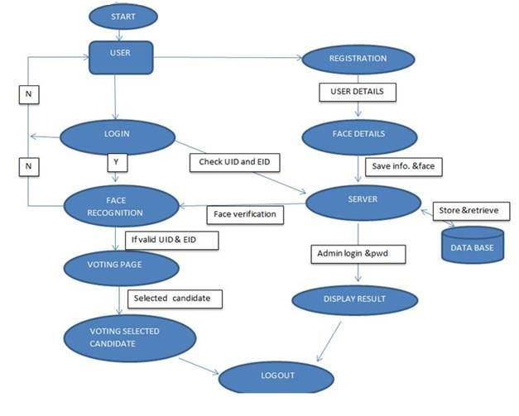
Working Flow of project
This slide shows working flow of the project

Slide 15
Cnn Algorithm
For face recognition we are going to use convolutional neural network(CNN) algorithm it is a sub field of Deep learning.It is a multi-layer network trained to perform a specific task using classification. Transfer learning of a trained CNN model is done for face recognition.
STEP
STEP
STEP
01
02
03
Training data set
Feature maps
Label
Training data set in which the give image is divided into motifs and sub motifs of atomic elements.
After each layer of convolution a stack of layers together form a feature maps and these are used In next level
After more than 3 levels of CNN the label for corresponding image in database is extracted

Slide 16
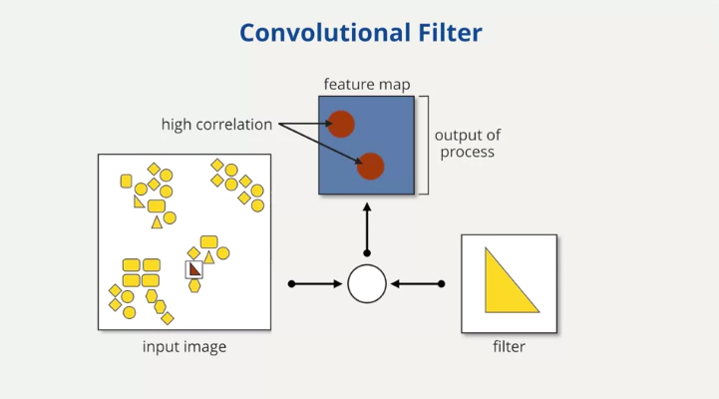
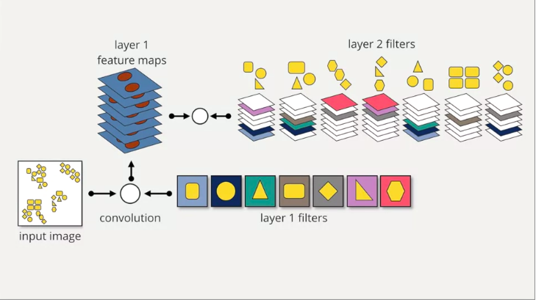
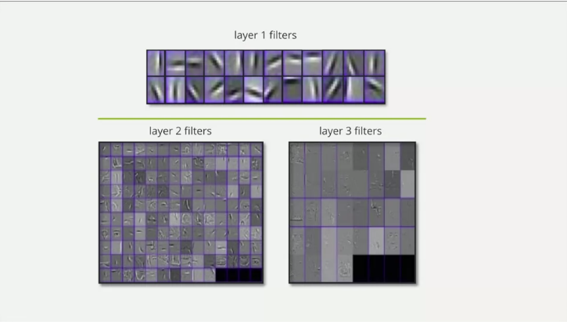
CNN ALGORITHM(Cont.)

Slide 17
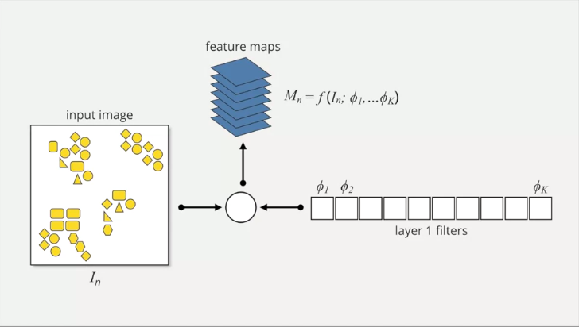
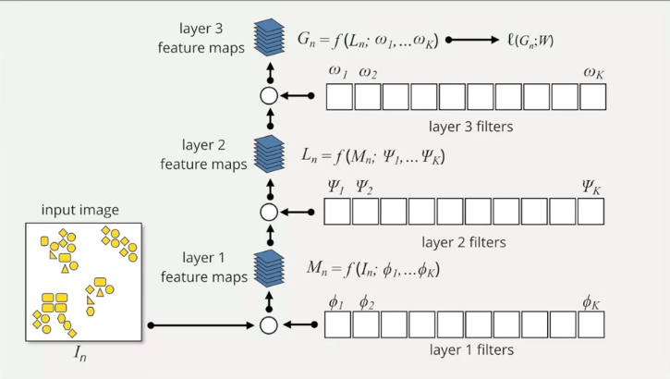
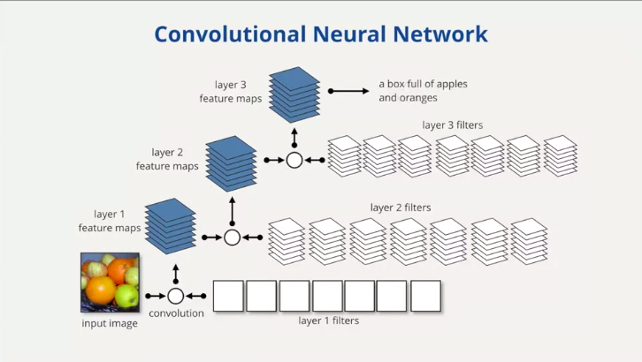
CNN ALGORITHM(Cont.)

Slide 18
CNN ALGORITHM(Cont.)
Non- Linear Graph

Slide 19
Traditional ml vs transfer learning
This shows a difference between Traditional ML vs Transfer Learning
Isolated single task learning
Previous tasks learning
Knowledge is not retained
COMPARISION
Faster and more accurate
Left side gives about Traditional ML on the other hand right side gives idea about transfer learning
More training data required
Less training data required

Slide 20
Traditional ml vs transfer learning

Slide 21
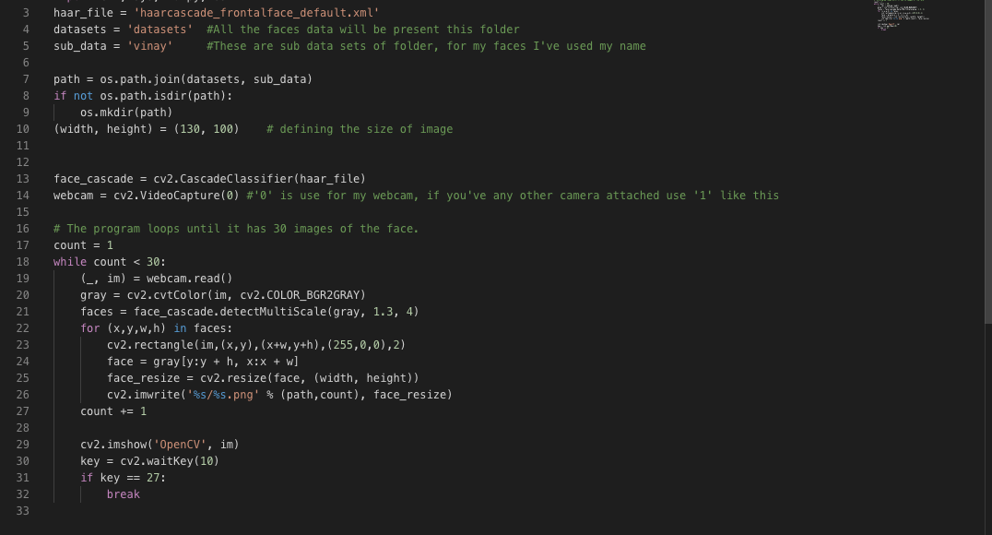
Real time project demo
This steps shows real time demo of the project we are talking about for creating database

Slide 22
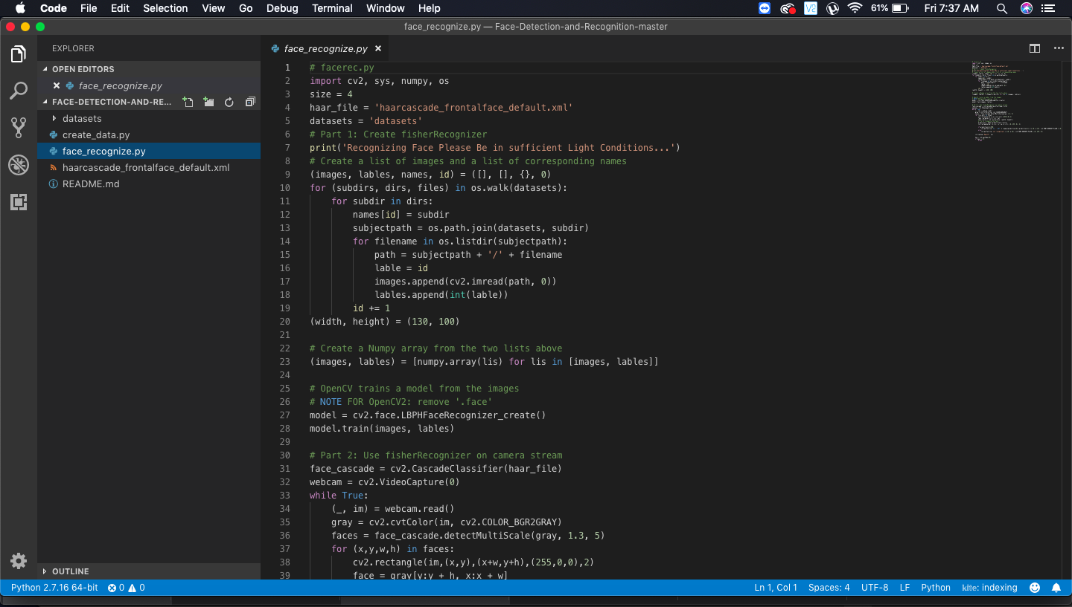
Real time project demo
This steps shows real time demo of the project we are talking about

Slide 23
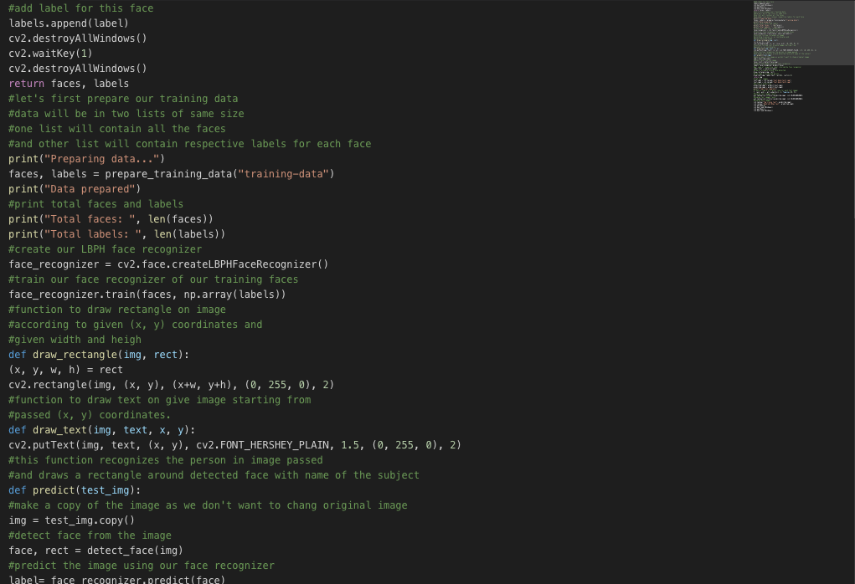
Real time project demo
This steps shows real time demo of the project we are talking about for creating labels

Slide 24
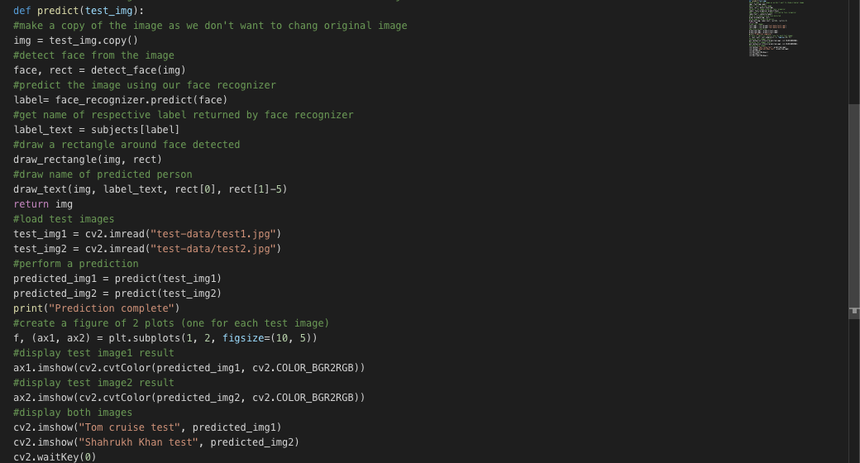
Real time project demo
This steps shows real time demo of the project we are talking about for showing results

Slide 25
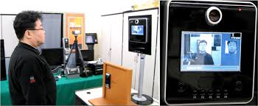
Real time project demo
This steps shows real time at polling station of the project we are talking about

Slide 26
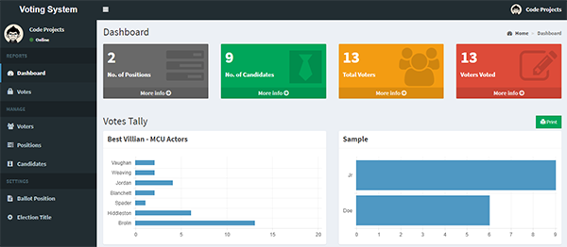
Real time project demo
This steps shows real time dashboard mockup of the project we are talking about

Slide 27
advantages of proposed system
These are some advantages of proposed system
Dummy votes
savings
We can keep checkmate for the dummy votes by using authentication
Lot of money can be saved as results are updated in short time and authentication is done by system.
No Travel
secure
Individual need not to travel he/she can vote at near by polling station.
There is less chance of individual casting multiple votes because this system has 3 level authentication
results
Efficiency
The winner of the elections can be announced and updated to people in less time using this system,
The algorithm gives 92% efficiency rate thus having high chances for better performance in future

Slide 28
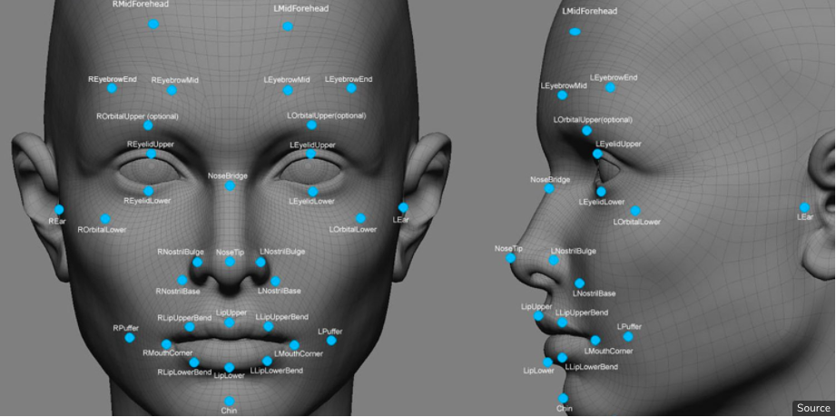

Slide 29
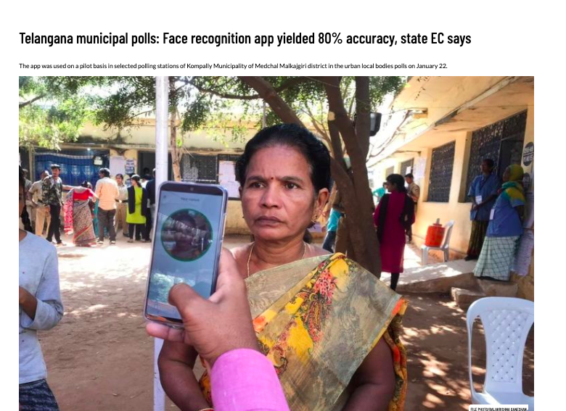
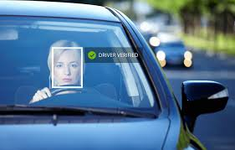
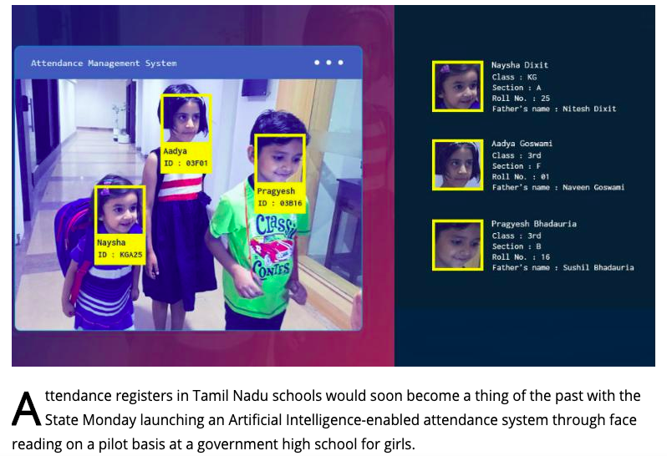
FUTURE project
This images shows future of this facial recognition

Slide 30
Conclusion
The proposed system will be beneficial in a number of ways. The voter verification will be done through face recognition. Only the verified voter can vote, hence dummy voting will be eliminated. A voter can vote only once. So, voting multiple times or dummy voting shall be prohibited. Moreover, being a smart device, there is no geographical and time constraint. Being automated system, election in different slots need not be arranged. It can be organized on the same day all over the country. The voting result can be generated automatically and quickly. Also very less resources and man power will be utilized for execution of the system that will lead to overall reduction in cost. The proposed system is non-interfering, centralized, and economic as well time centric.

Slide 31
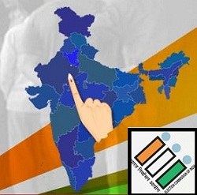
Thank you!!
BY:
K.VINAY KUMAR REDDY

